Slide 1

Automotive Technology: A Systems Approach, 8e
Chapter 38: Manual Transmission and Transaxles
Rob Thompson and Jack Erjavec, Automotive Technology: A Systems Approach, 8th Edition. © 2025 Cengage. All Rights Reserved. May not be scanned, copied or duplicated, or posted to a publicly accessible website, in whole or in part.

Slide 2
Chapter Objectives (1 of 2)
38.01 Explain the design characteristics of manual transmissions and transaxles.
38.02 Explain the design characteristics of the gears used in manual transmissions and transaxles.
38.03 Explain the fundamentals of torque multiplication and overdrive.

Slide 3
Chapter Objectives (2 of 2)
38.04 Describe power flow through forward and reverse gear ranges.
38.05 Describe the purpose, design, and operation of internal and remote gearshift linkages.
38.06 Explain the operation of automatically shifted manual transmissions and transaxles.

Slide 4
Transmission Versus Transaxle
38.01 Explain the design characteristics of manual transmissions and transaxles.
RWD vehicles use a transmission.
  A drive shaft links the transmission to the differential and drive axles.
FWD vehicles use a transaxle.
  Combines transmission gearing, differential, and drive axle connections
4WD vehicles use a transmission and transfer case.

Slide 5
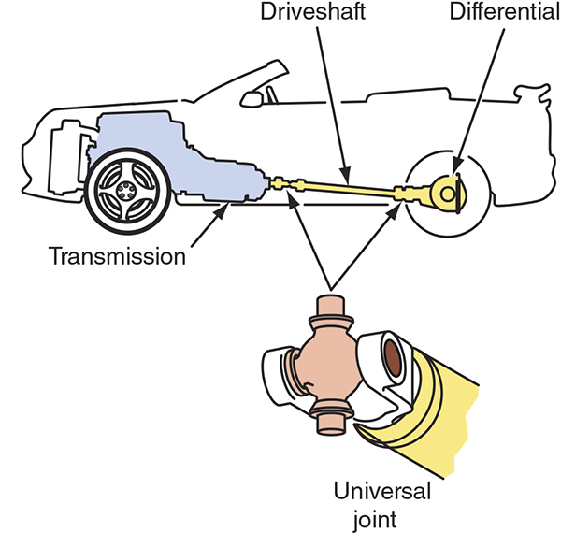
Typical RWD

Slide 6
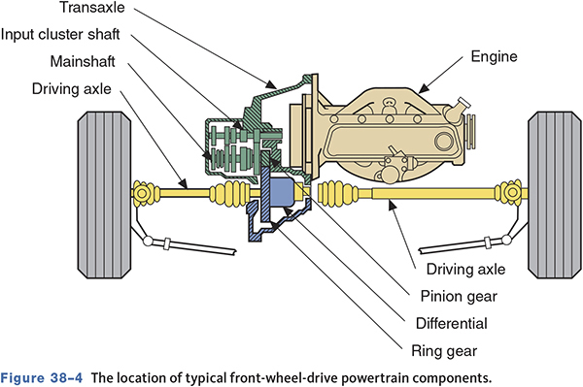
Typical FWD

Slide 7
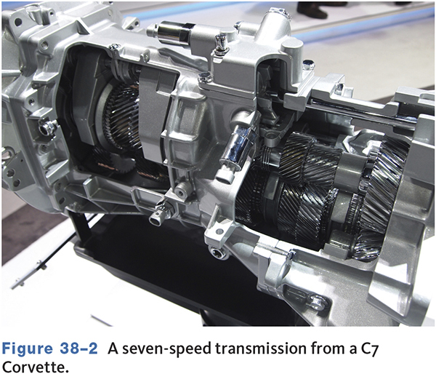
Transmission Designs
Three to seven gears
Six speeds are most common.
At least two gears are overdrive gears.

Slide 8
Gears
38.02 Explain the design characteristics of the gears used in manual transmissions and transaxles.
Transmit rotation motion from one parallel shaft to another
The shaft can drive the gear, the gear can drive the shaft, or the gear can be free to turn on the shaft.
Gears can increase or decrease torque and speed.

Slide 9
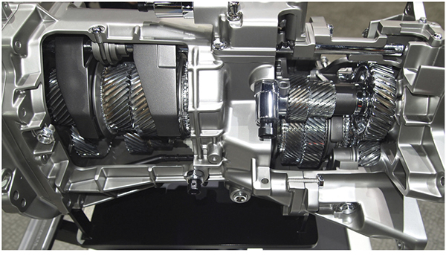
The Gear in a Transmission Transmit the Rotating Power

Slide 10
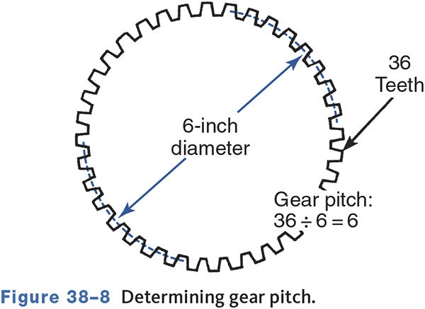
Gear Design
Gear pitch refers to the number of teeth per unit of pitch diameter.
  Divide the number of teeth by the pitch diameter
Only gears of the same pitch can operate together.

Slide 11
Gear Designs
Spur Gears
  Simplest design, tooth contact causes clicking
Helical Gears
  Can be right or left handed
  Allows for two or more teeth to mesh at the same time
Idler Gears
  Placed between the drive and driven gears

Slide 12
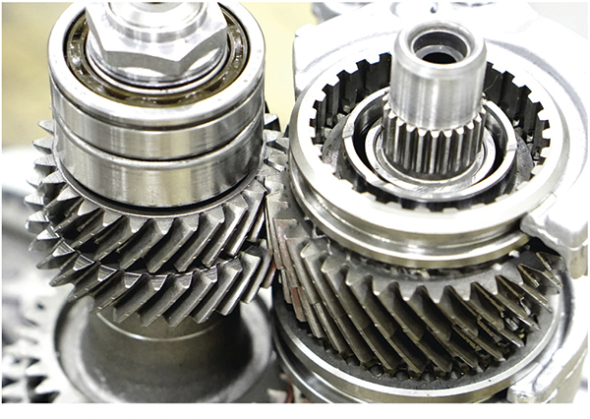
Helical Gears

Slide 13
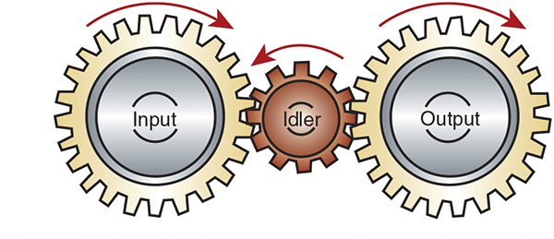
Idler Gear

Slide 14
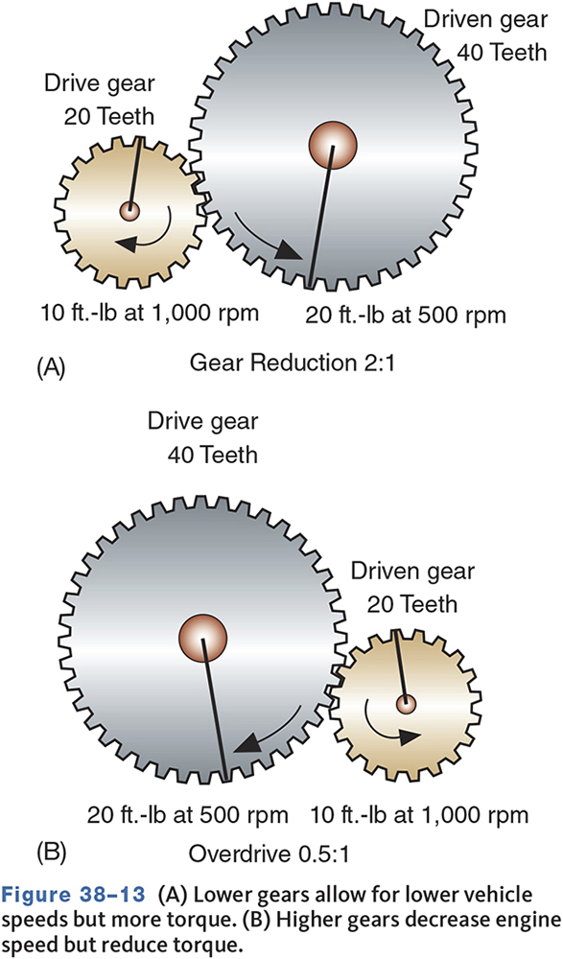
Definition of Gear Ratios
38-03 Explain the fundamentals of torque multiplication and overdrive.
Express the mathematical relationship of one gear to another
Express the amount of torque multiplication between gears
Tell how many times one gear turns in relation to the other

Slide 15
Calculating Transmission Gear Ratios
Calculate the ratio of the first set of gears by dividing the driven (output) gear by the drive (input) gear.
Do the same for the second set of gears.
Multiply the answer from the first calculation with the answer from the second calculation.
Driven A/Drive A x Driven B/Drive B = Ratio

Slide 16
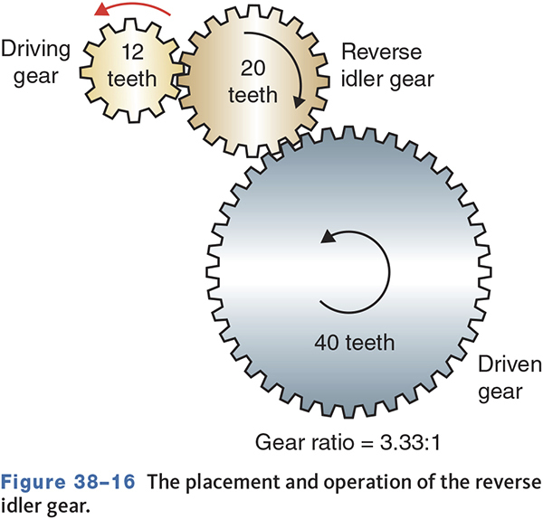
Reverse Gear Ratio

Slide 17
Knowledge Check (1 of 2)
Technician A says a gear ratio of 3.5:1 is an overdrive ratio.
Technician B says a gear ratio of 0.85:1 is an overdrive ratio.
Who is correct?

Slide 18
Knowledge Check Answer (1 of 2)
Technician A says a gear ratio of 3.5:1 is an overdrive ratio.
Technician B says a gear ratio of 0.85:1 is an overdrive ratio.
Who is correct?
Answer: Technician B only

Slide 19
Transmission and Transaxle Design
Synchromesh Transmissions
  Gears are constant mesh and collar shifted.
  Collars are equipped with synchronizers.
  Synchronizers eliminate the need to equalize gear speeds before engagement.
  They are used on all current models of cars.

Slide 20
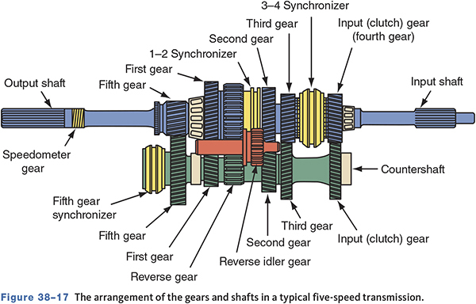
Transmission Features

Slide 21
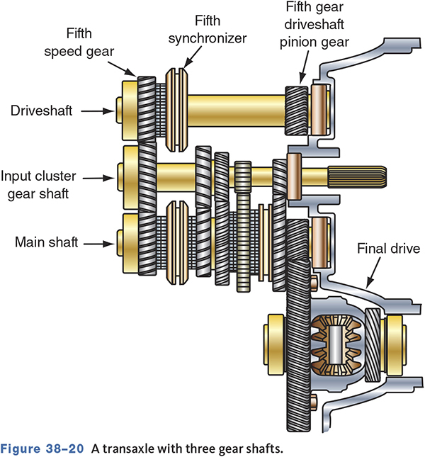
Transaxle Features

Slide 22
Synchronizers
Brings components at different speeds to one synchronized speed.
Locks the pinion shaft and speed gear.
May have spur gear teeth cut into outside and act as reverse gear.
All forward gears synchronized in modern transmissions/transaxles.

Slide 23
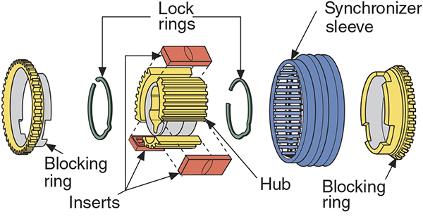
Synchronizer Assembly

Slide 24
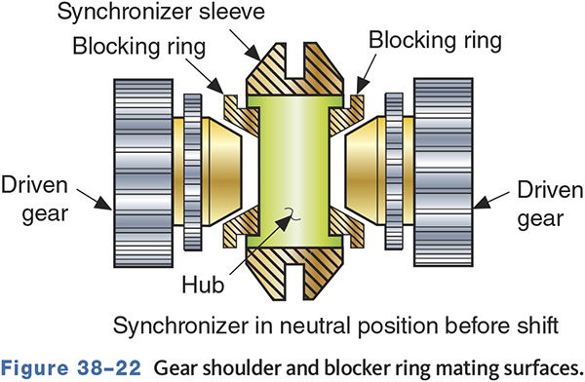
Block or Cone Synchronizers
Hub—splined to pinion shaft.
Sleeve—slides onto hub.
Blocking ring—brass or bronze ring forms the outer half of the gear shoulder cone.
Inserts or spring-and-ball detent devices.

Slide 25
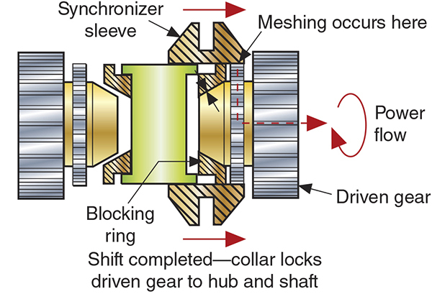
Gear Shoulder and Blocker Ring Mating

Slide 26
Advanced Synchronizer Designs
Multiple cone-type synchronizers.
Use friction material on both sides of the synchronizer rings.
Decreases shift effort and increases durability.
Reduces transmission size since a smaller synchronizer can perform as a larger one.

Slide 27
Gearshift Mechanisms
38.05 Describe the purpose, design, and operation of internal and remote gearshift linkages.
Shift rails transfer motion from the gearshift to the shift forks.
The shift forks rest in grooves in the synchronizer sleeves.
Linkage can be direct or remote and internal or external.

Slide 28
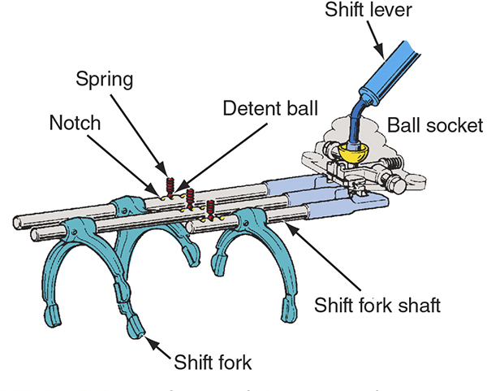
Gearshift Linkage
Internal-Type
  Uses a shift rail and detents to select and maintain gear selection.
External-Type
  Uses levers and rods that are connected to the outside of the transmission.

Slide 29
Transmission Power Flow
38.04 Describe power flow through forward and reverse gear ranges.
Neutral
  The input shaft drives the counter shaft.
  All of the gears on the main shaft rotate.
  The synchronizers are not engaged with any gear.
  No power is transferred to the output shaft.

Slide 30
Power Flow
Forward Gears
  The power enters transmission through the input shaft.
  The synchronizer sleeve is engaged with the dog teeth of the selected gear.
  The power is transferred from the input shaft, through the counter shaft, and up to the selected gear.
  The gear drives the output shaft.

Slide 31
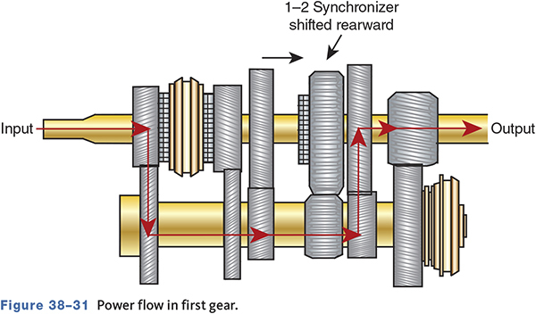
Power Flow in First Gear

Slide 32
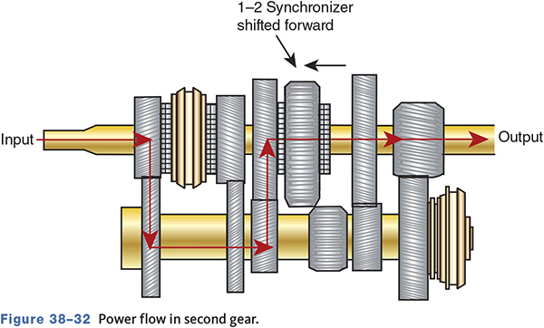
Power Flow in Second Gear

Slide 33
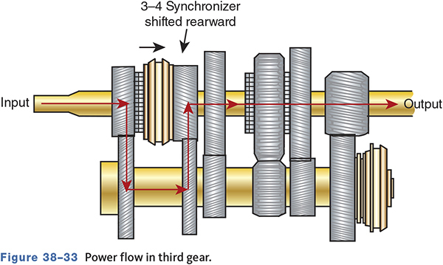
Power Flow in Third Gear

Slide 34
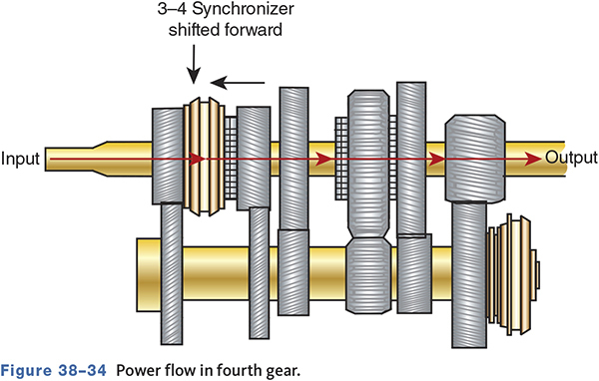
Power Flow in Fourth Gear

Slide 35
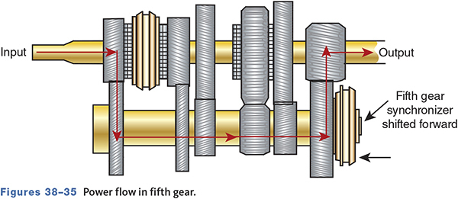
Power Flow in Fifth Gear

Slide 36
Power Flow in Reverse (1 of 2)
Reverse
  The power enters transmission through the input shaft.
  The reverse gear synchronizer sleeve is engaged with the reverse gear dog teeth.
  The power is transferred from the input shaft, through the counter shaft, through the reverse idler gear, and up to the reverse gear.
  The reverse gear drives the output shaft in reverse.

Slide 37
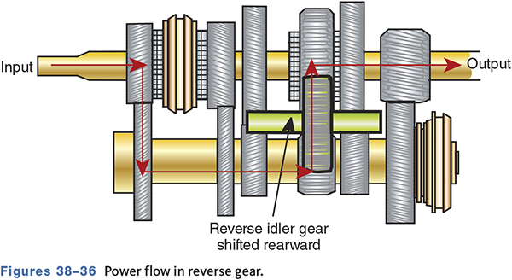
Power Flow in Reverse (2 of 2)

Slide 38
Transaxle Power Flow (1 of 2)
Neutral
  The input shaft is being turned by the engine.
  The synchronizer collars are centered between their gear positions.
  The drive gears are not locked to the output shaft.
  No power is applied to the differential.

Slide 39
Transaxle Power Flow (2 of 2)
Forward Gears
  The gears on the input shaft are in constant mesh with those on the output shaft.
  The synchronizer hub is splined to the output shaft.
  When a gear is selected, the synchronizer collar engages the hub.
  The power flows from the gear on the input shaft through the selected gear on the output shaft.

Slide 40
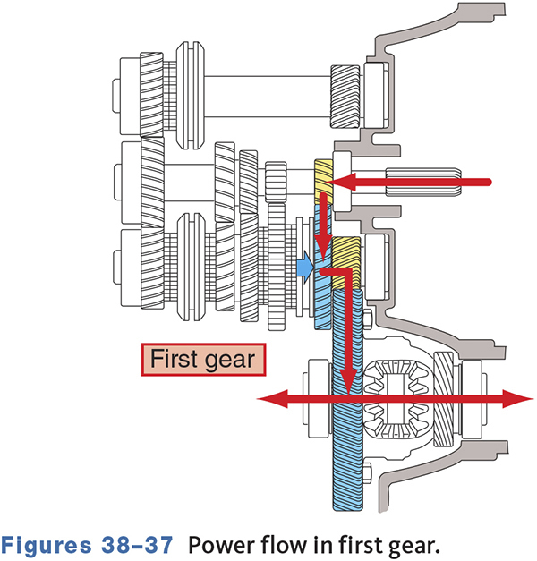
Transaxle Power Flow—1st Gear

Slide 41
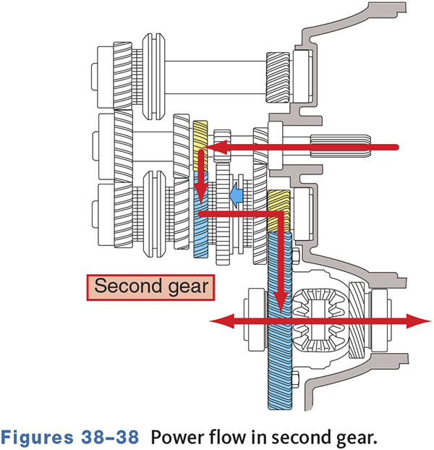
Transaxle Power Flow—2nd Gear

Slide 42
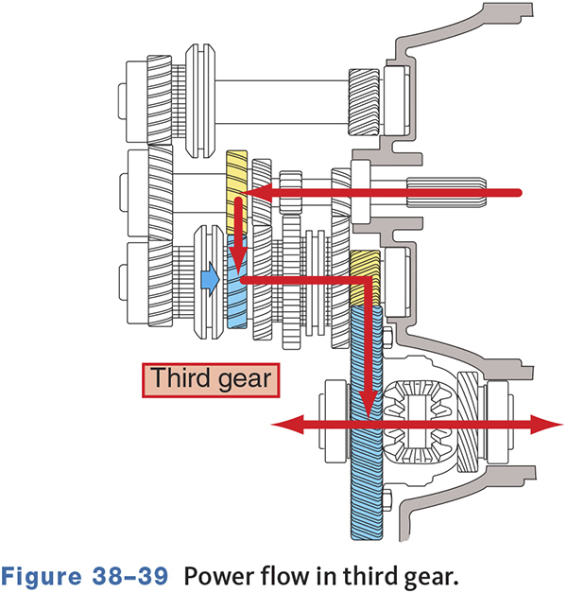
Transaxle Power Flow—3rd Gear

Slide 43
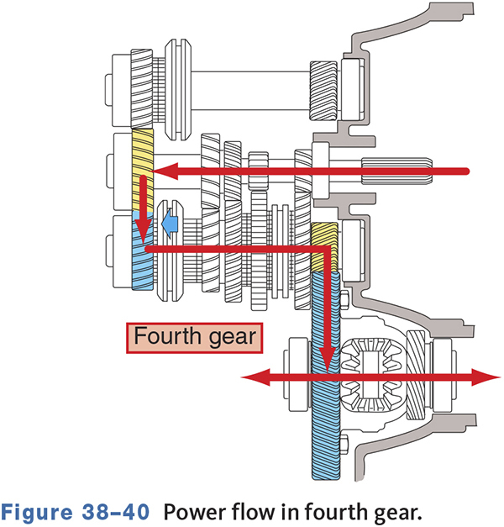
Transaxle Power Flow—4th Gear

Slide 44
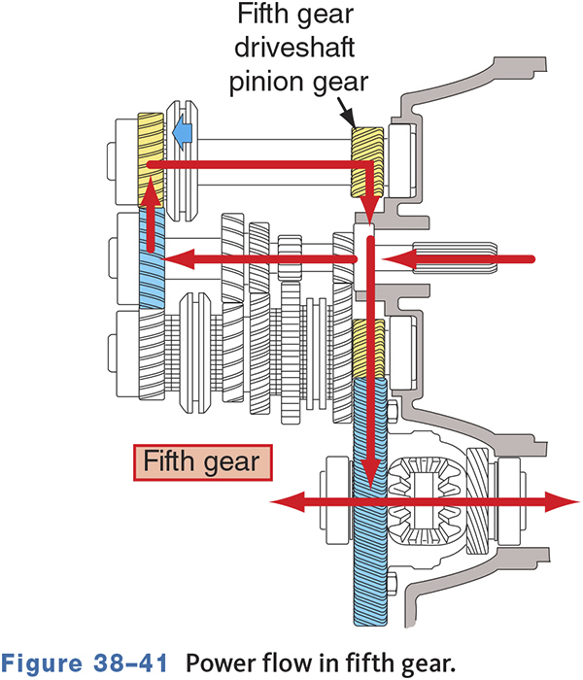
Transaxle Power Flow—5th Gear

Slide 45
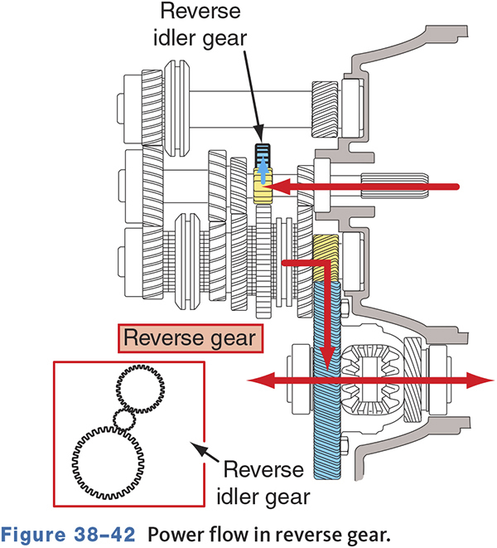
Transaxle Power Flow—Reverse

Slide 46
Knowledge Check (2 of 2)
Which of the gears in a typical RWD transmission is not synchronized?

Slide 47
Knowledge Check Answer (2 of 2)
Which of the gears in a typical RWD transmission is not synchronized?
Answer: Reverse

Slide 48
Differential Action
Final drive ring gear driven by the output shaft.
Usually does not need to turn 90 degrees.
Only provides torque multiplication and divide the torque to the axle shafts.
Provides additional gear reduction beyond the transmission/transaxle called the final drive gear.

Slide 49
Final Drive Gears and Overall Ratios
All vehicles use a gearset to provide additional gear reduction beyond the transmission.
This is called the final drive gear.
Located in the differential housing for transmission-equipped vehicles.

Slide 50
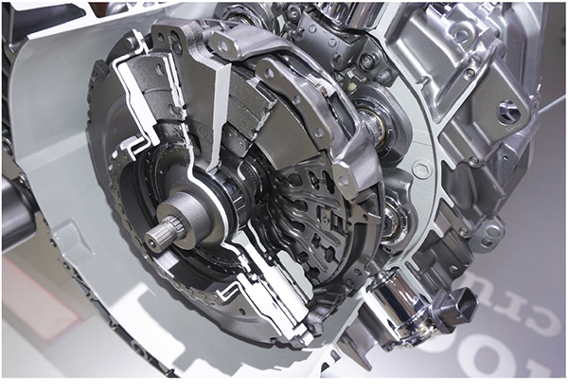
Dual Clutch Transmissions (DCTs)
38-06 Explain the operation of automatically shifted manual transmissions and transaxles.
Becoming very common.
Can change gears very fast.
Fuel economy improves.
Performance improves.

Slide 51
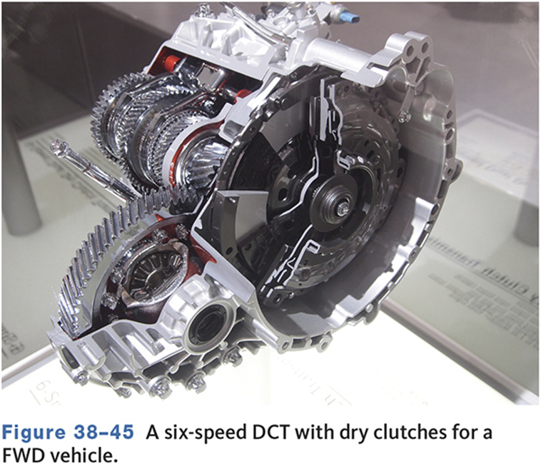
Input from the Engine
May use wet or dry clutches.
Dry clutches often used with smaller FWD vehicles.
Wet clutches often used on larger RWD vehicles.

Slide 52
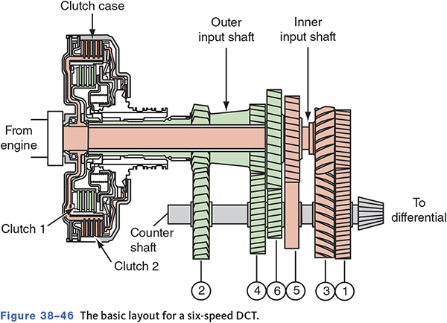
DCT Operation
A DCT has two separate shafts and sets of gears.
One shaft has the even gears, the other shaft the odd gears.
One clutch is for 1st, 3rd, and 5th gears.
The other clutch is for 2nd, 4th, and 6th gears.

Slide 53
Electrical Systems
Reverse Lamp Switch
  Usually on transmission but can be on linkage.
Vehicle Speed Sensor
  Sends speed signal to PCM.
Reverse Lockout Systems
  Prevents accidental shifting into reverse.
Shift Blocking
  Used to improve fuel economy.

Slide 54
Chapter Reflection
Write down the concept from this chapter that challenged you the most. Describe what made the concept difficult for you and the steps you took to improve your understanding.
How could you help another learner who was struggling with the same concept.
Use 100–150 words in your answer.

